Slide 1
Datasci in finance
Norman Niemer
http://tiny.cc/datasci-finance

Slide 2
Virtuous circle
Passion
Unique ability
Supply / demand

Slide 3
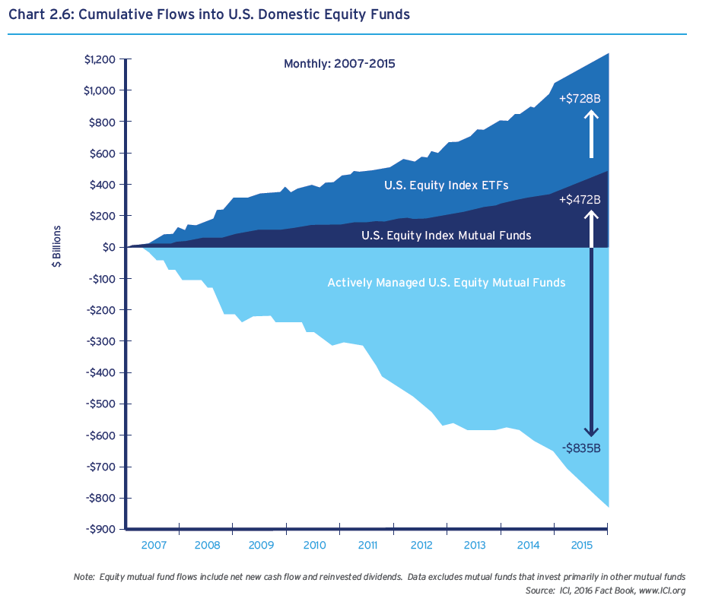
SUPPLY/DEMAND PICTURE IN ASSET MANAGEMENT

Slide 4
My Background
Early 10s: computer games+admin, coding
Late 10s: tech entrepreneur
Early 20s: finance, M&A
Late 20s: data-driven investment research
Early 30s: data science

Slide 5
What we do
Value add:
Behavioral analytics
Alpha generation
Portfolio/Risk management
Biz dev
School Subjects Used: coding, optimization, machine learning, stats/econometrics
Subjects not learned in school: (software) engineering, portfolio management, investments / markets (CFA), company/market valuation (CFA), AI, marketing/sales

Slide 6
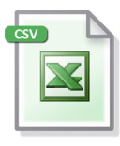

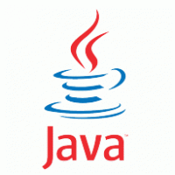
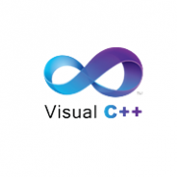
HOW we do it
Reference: Quant stack

Slide 7

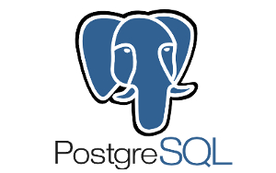

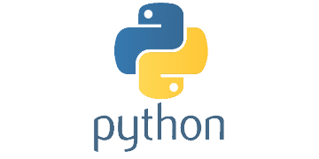

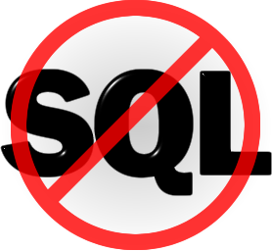
HOW we do it
Datascience stack

Slide 8
HOW we do it
Datascience stack details https://github.com/citynorman/datasci-finance/blob/master/references.ipynb

Slide 9
Interview process
15mins phone screen
Complete coding test
30mins with team members
Work on creative project
Present project and 30mins with senior managers

Slide 10
Coding test
Pandas munging (ETL): indexing, altering
Pandas computations: grouping, rolling apply
Linux CLI
SQL
Stats: time series modeling
Machine learning: CV, RF
Portfolio Optimization
Bonus: hadoop spark

Slide 11
Coding prep
https://github.com/citynorman/datasci-finance/blob/master/pandas.ipynb

Slide 12
Datasci beyond finance
Virtual (shopping) assistants (Techcrunch, Mastercard)
VR (Stamford innovation center)
Expertise finding (Fintech #2)
Document tracking (Fintech #1)
Robotics for kids
Open source portfolio management

Slide 13
Datasci frontier
https://github.com/citynorman/datasci-finance/blob/master/references.ipynb

